Slide 1


Acquisition and Processing of Motion Tape Field Data
`
Matthew Makila, Taylor Pierce, Yun-An Lin, and Prof. Ken Loh
Department of Structural Engineering
Designing for Safety and Safety by Design 2022
Active, Responsive, Multifunctional, and Ordered-materials Research (ARMOR) Lab
August 1, 2022

Slide 2
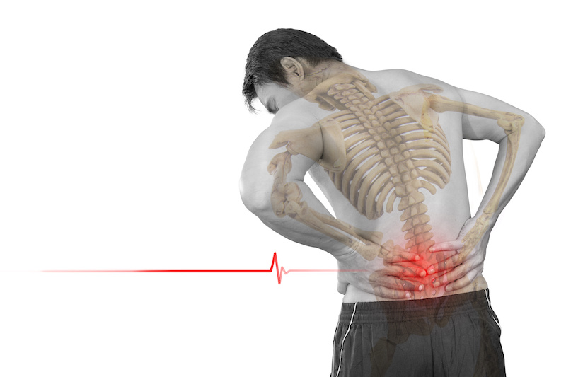
Motivation
In highly strenuous physical activity, the risk of musculoskeletal injuries and strain on the body is high.
Wearable sensors have been created to prevent these injuries, but few capture the specific stress from our muscle engagements like Motion Tape.
Notes:
Movement crucial to everyday life

Slide 3
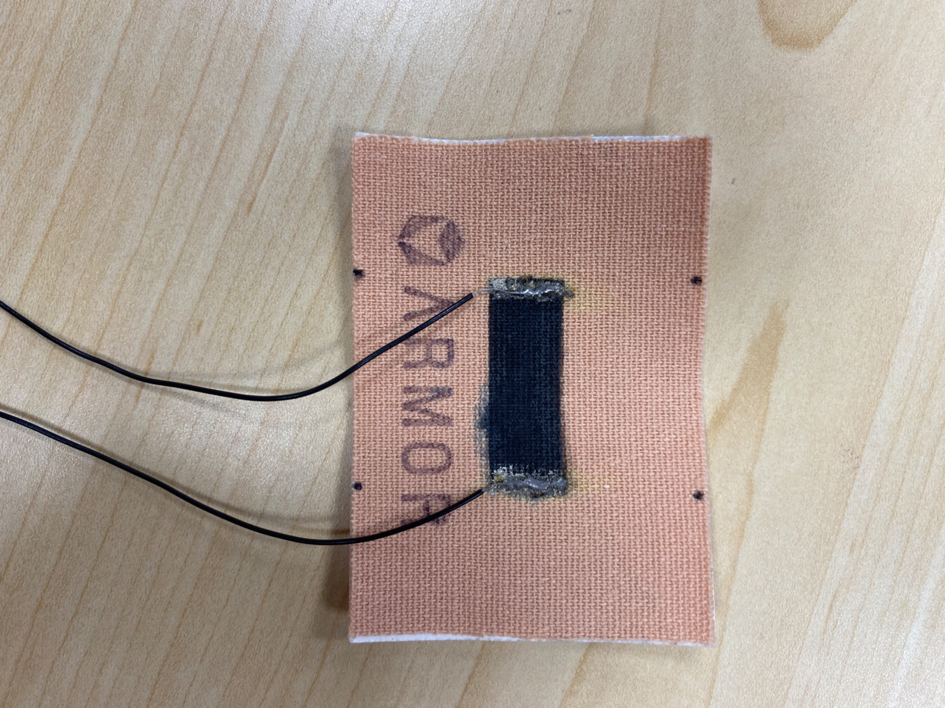
What is Motion Tape?
Motion Tape is a graphene nanocomposite film combined with commercially-developed kinesthetic tape via spray-coating.
As a piezoresistive material, its resistance will change as it is bent.
Fig. 1. A piece of Motion Tape
Notes:
specify who does each one

Slide 4
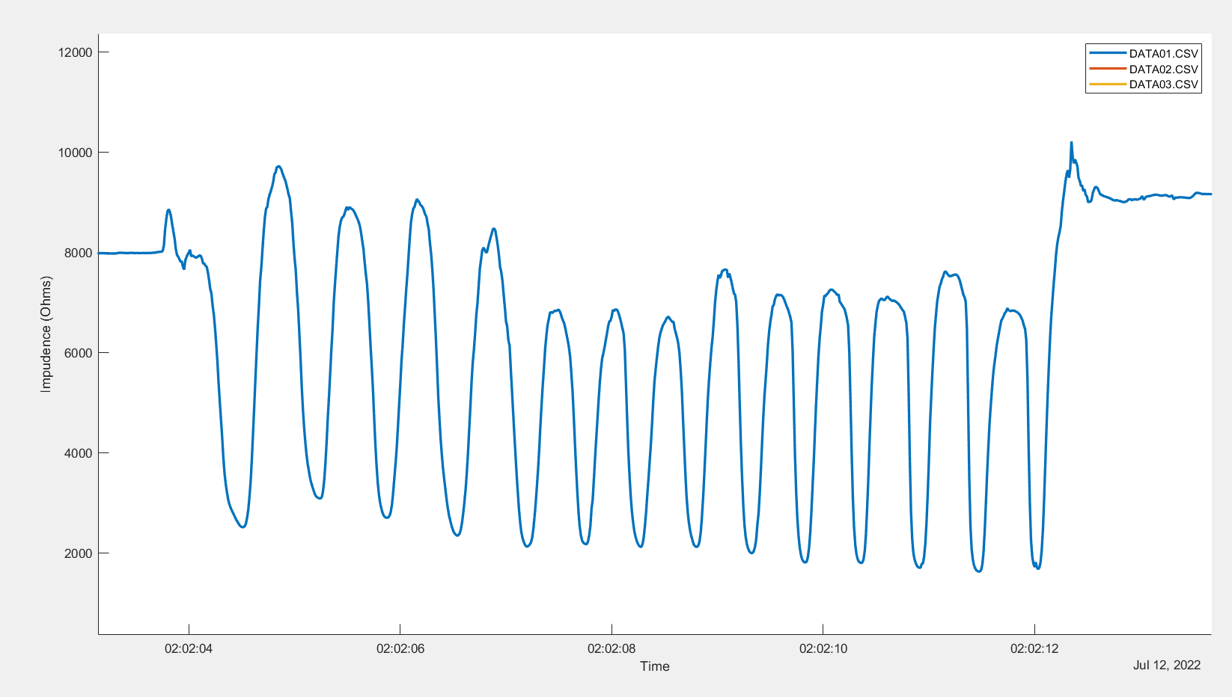

Goal for Study
The main objective was to automate data processing from the Motion Tape system for rapid field analysis
Notes:
This meant being able to take field tests and process all information from them in the same day

Slide 5
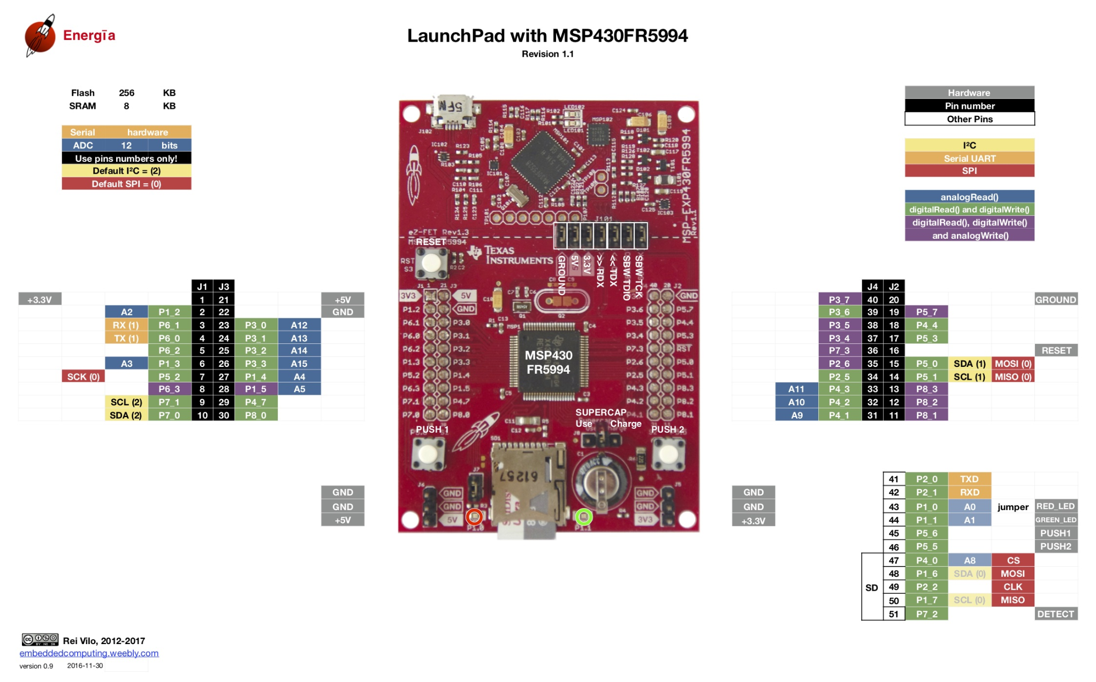
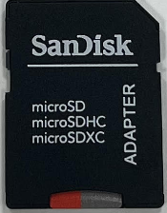
Initial Steps: Data Acquisition
MSP430FR5994 Microcontroller used to gather Motion Tape sensor data to a microSD card, collecting about 90 SPS of Motion Tape data
Fig. 3. The microSD storage device
Fig. 2. MSP430 Board Schematic
Notes:
https://energia.nu/pinmaps/msp-exp430fr5994/

Slide 6
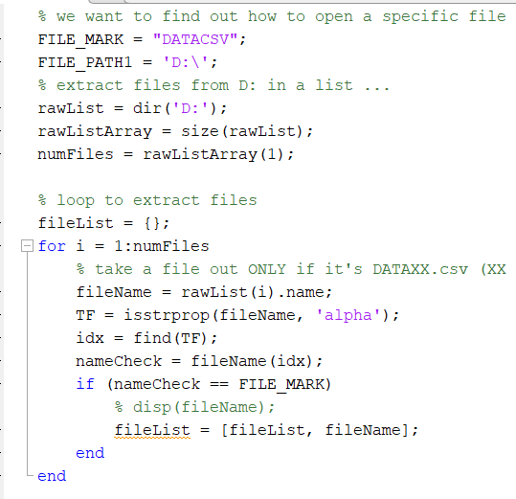
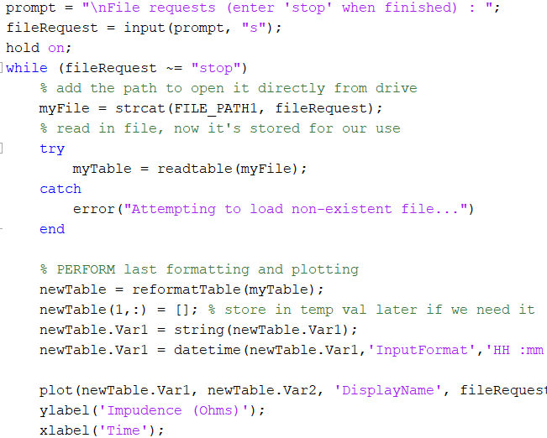
Automating Data Collection
Data was collected from the MSP430, but what next?
Script written to extract data from the microSD card and user features were added
Fig. 4. Gathering data files from inserted local disk (microSD)
Fig. 5. Asking user for file selections and initiating data reformation (reformatTable)

Slide 7
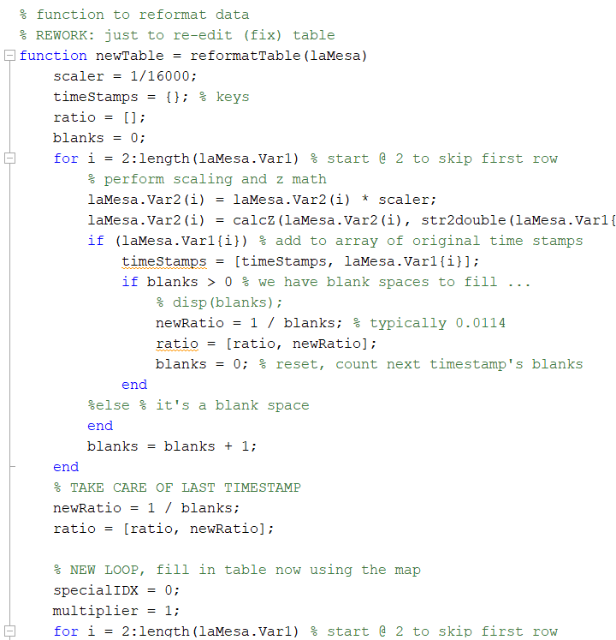
Automating Data Collection
Imported data had “gaps” between timestamps to take samples quickly; these had to be filled to successfully plot data
Fig. 6. In this portion, timestamp “gaps” are filled for each of the 90 samples taken in a second
Notes:
why are the gaps there. add timestamps later to be more efficient while we sample

Slide 8
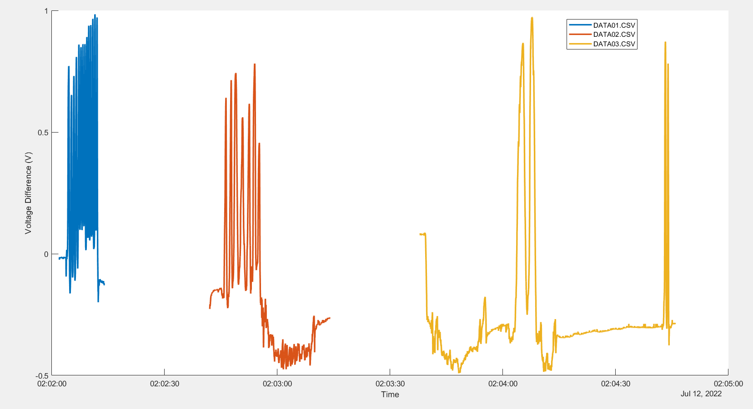
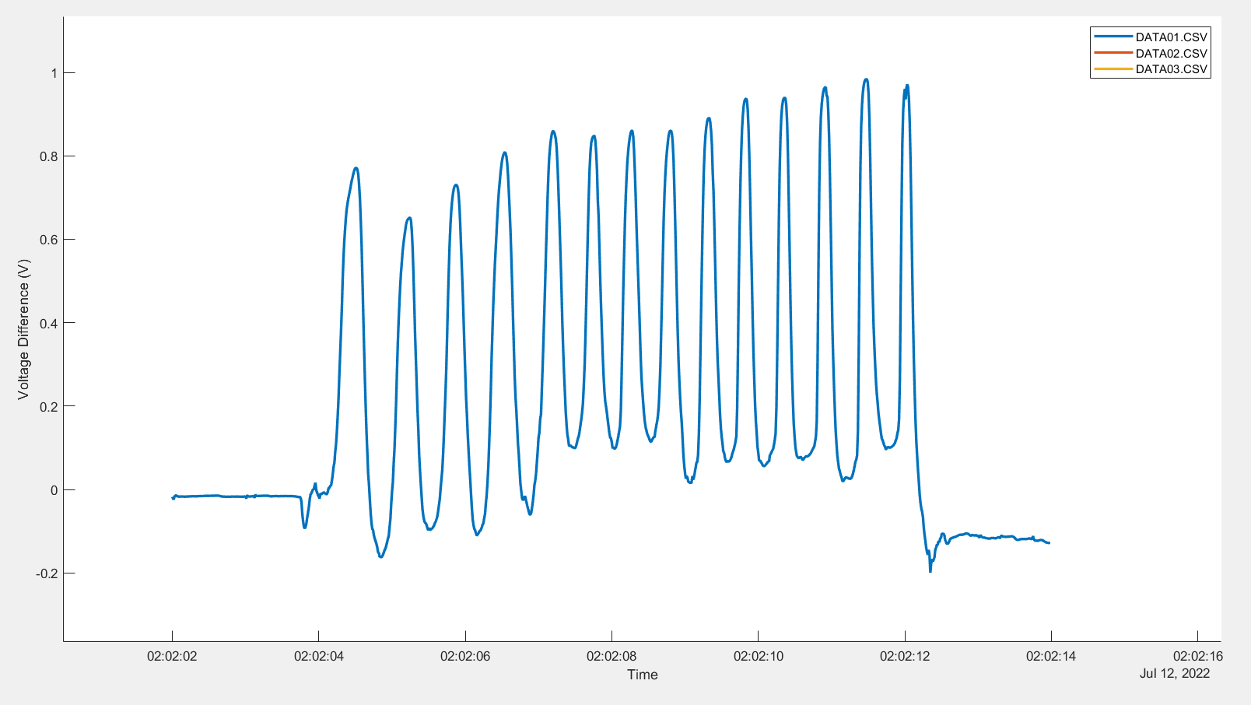
Graphical Data: Raw Voltage vs. Time
Fig. 7. Three sample data files collected over several hours plotted alongside one other in chronological order against the voltage difference

Slide 9
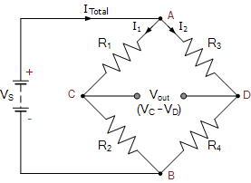
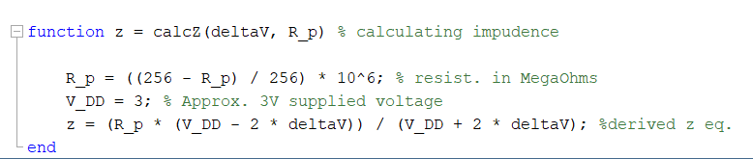
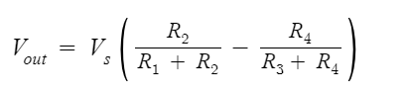
Wheatstone Bridge and Impedance
After initially plotting data, it was converted into impedance.
Impedance related to supplied voltage and other circuit components via a Wheatstone Bridge.
Allows us to turn single-ended signal to differential ended signal and minimize supply noise
Fig. 8. The impedance value is calculated from the supplied voltage, resistance of the potentiometer, and the scaled value for voltage difference.
Fig. 9. Diagram of wheatstone bridge and corresponding equation relating components.
Notes:
Wheatstone Bridge Circuit and Theory of Operation (electronics-tutorials.ws)

Slide 10
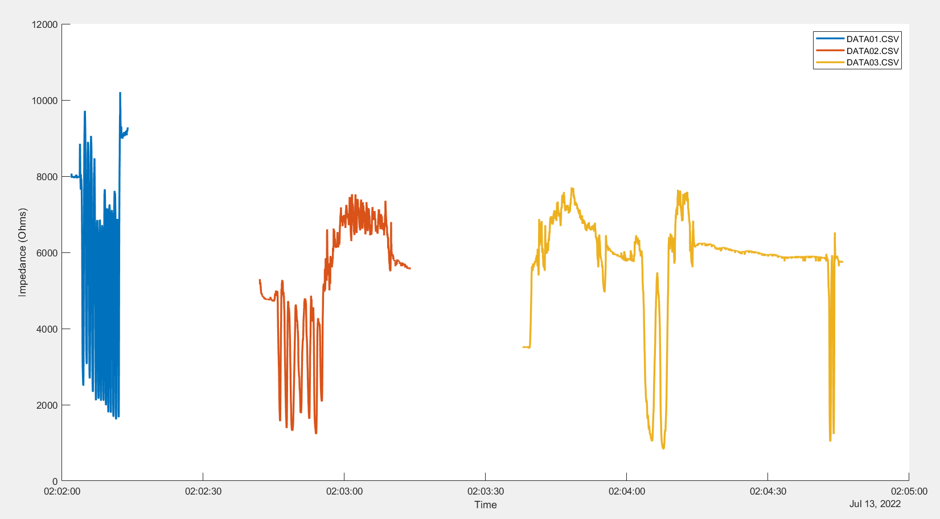
Graphical Data: Impedance vs. Time
Fig. 10. The same three sample data files updated to be plotted against impedance

Slide 11
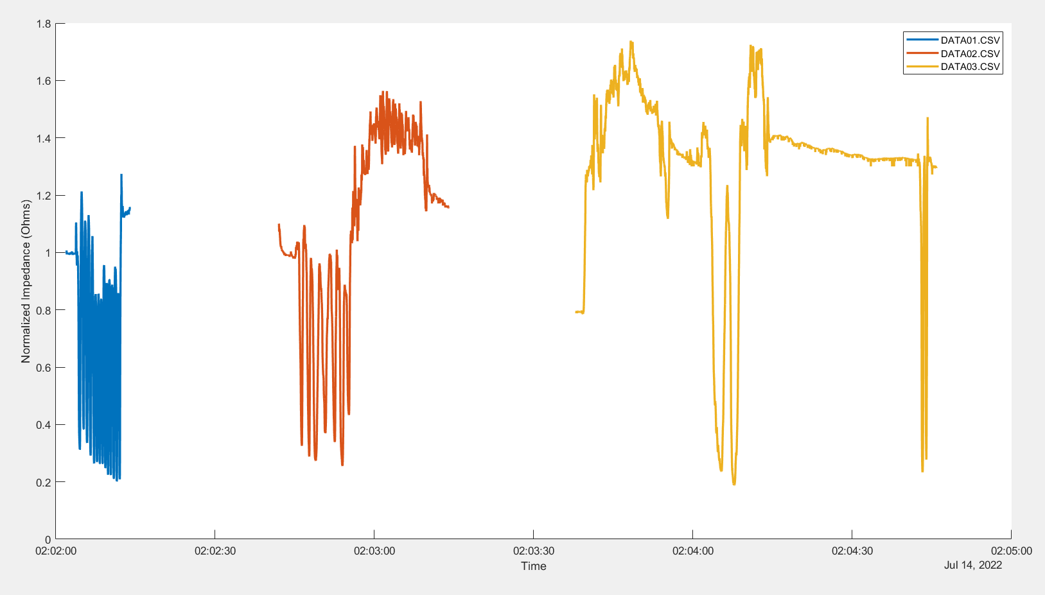
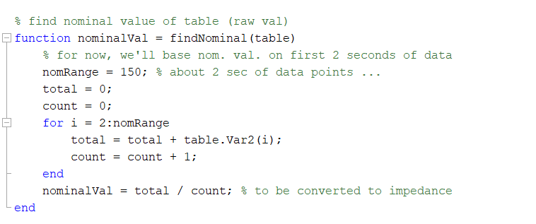
Data Analysis: Normalized Impedance
To graphically represent strain, the previous data had to be normalized
This keeps data flexible and allows differ samples to be compared
Fig. 11. Created a function to find nominal value from beginning of collected data set in order to make data flexible and easily scalable
Fig. 12. Graphical representation of Normalized Impedance from 3 chronologically plotted data files
Notes:
describe what nominal value is,
how it was calculated,
and why we wanted to normalize the data

Slide 12
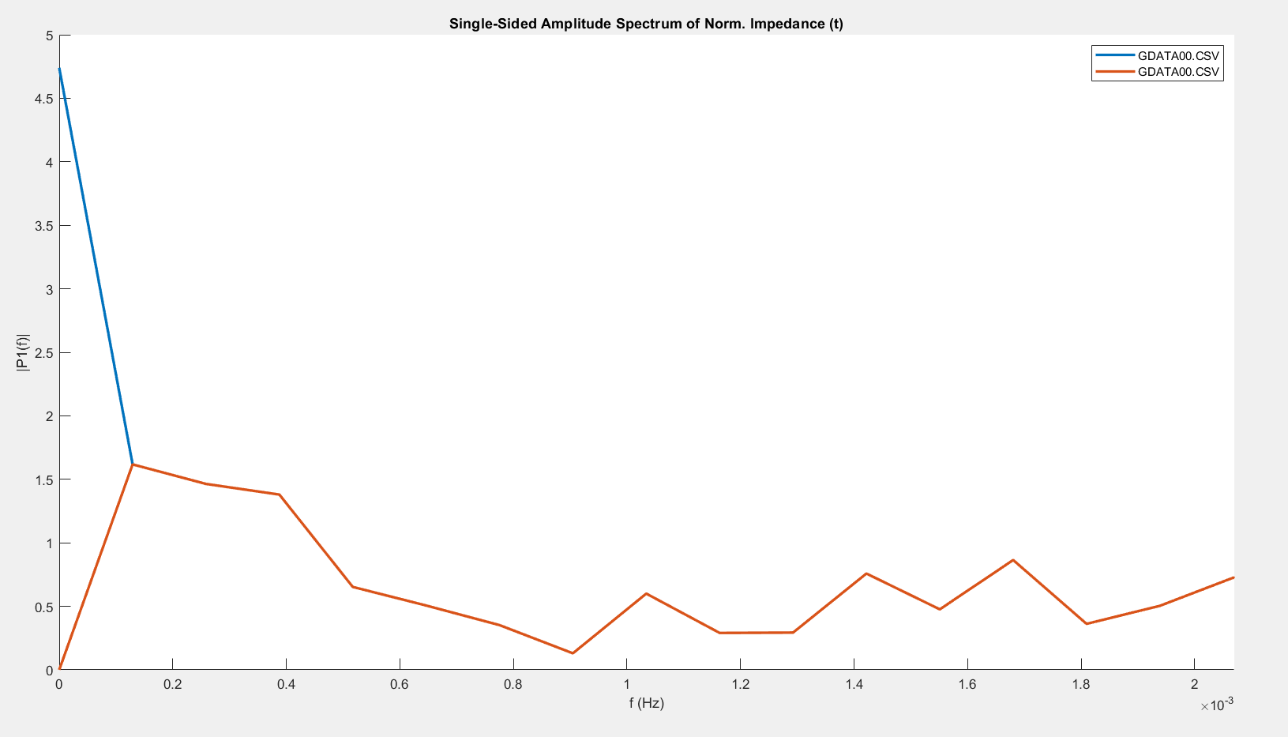
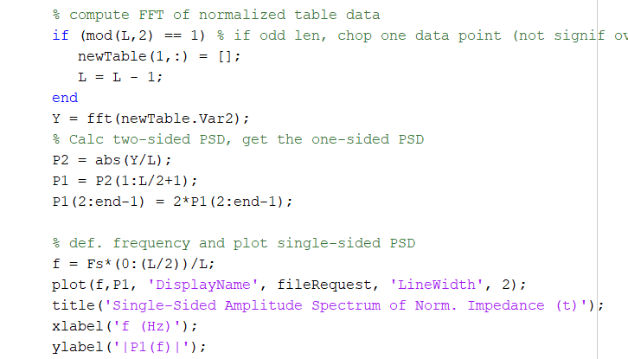
Data Analysis: Fast Fourier Transform
Using normalized data, calculated the Fast Fourier Transform (FFT)
Isolates signals (like breathing) and filters noise which all make up the strain
Fig. 13. Function written to determine the FFT of a data table extracted from our data files.
Fig. 14. Sample data with Power Spectral Density (PSD) plotted against Frequency. A before (blue) and after (orange) zero average mean treatment to FFT data.
Notes:
we used FFT (a function) to isolate signals making up the strain
what’s FFT
Matlab has built-in fft but I had to extract the proper parts of dataset to utilize it fully
incorporates PSD which is val resulting from the fft function

Slide 13
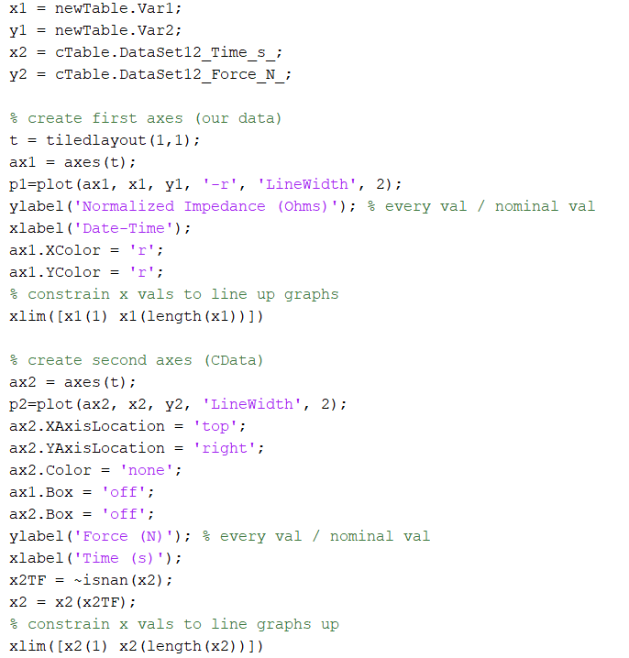
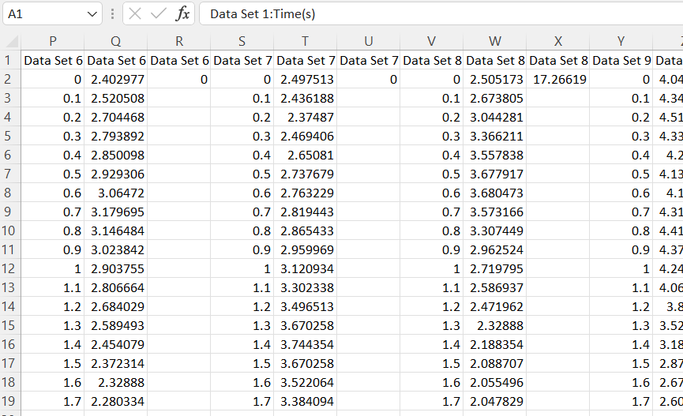
Results: Processing Field Samples
With the script complete, field tests were conducted to analyze and compare Motion Tape data with data from a commercial device.
Fig. 15. Screen capture of minor portion of commercial data. The data here was recorded differently than the data from our Motion Tape.
Fig. 16. Script function to process data from both devices and then plot all data aligned properly
Notes:
Describe commercial dataset and differences from ours
why it was difficult to plot

Slide 14
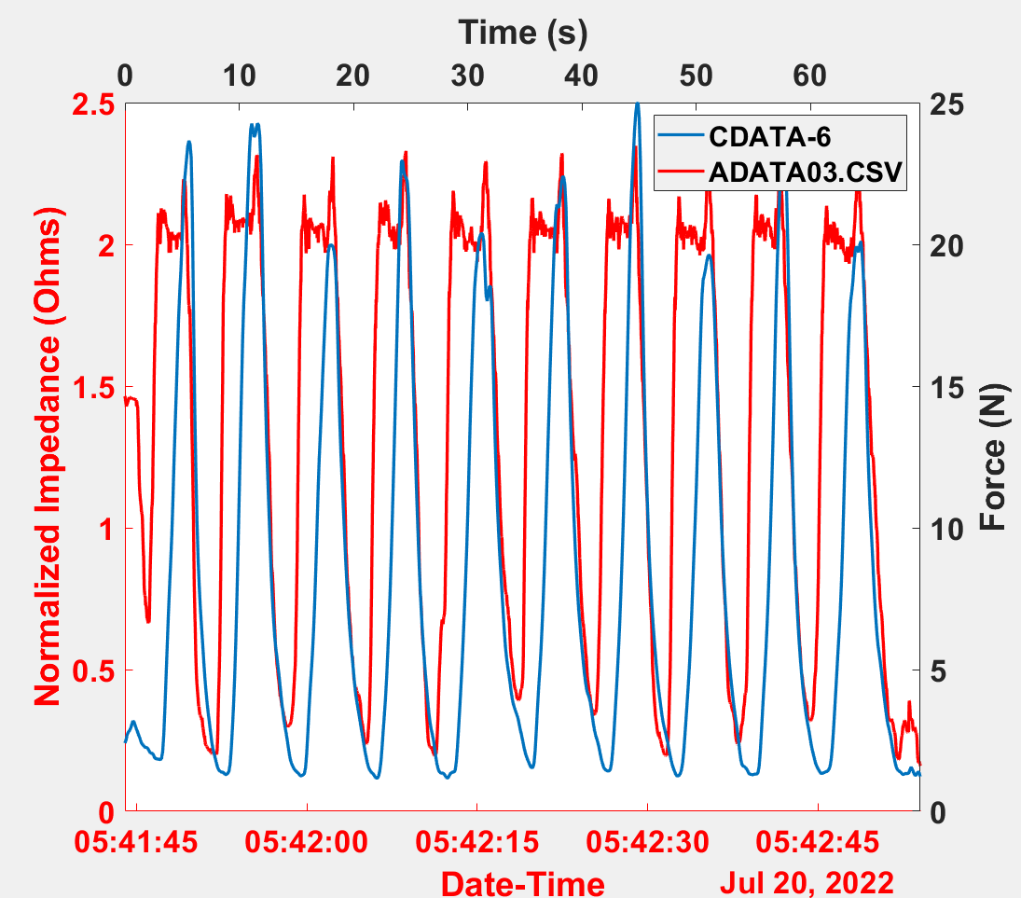
Graphical Data: Field Samples
The two variants of given data samples used different metrics for independent and dependent variables, so a double-axes was deployed.
Fig. 17. Field data gathered from the commercial device (blue) plotted against our device (red).
Notes:
describe figure and diff variables on it

Slide 15
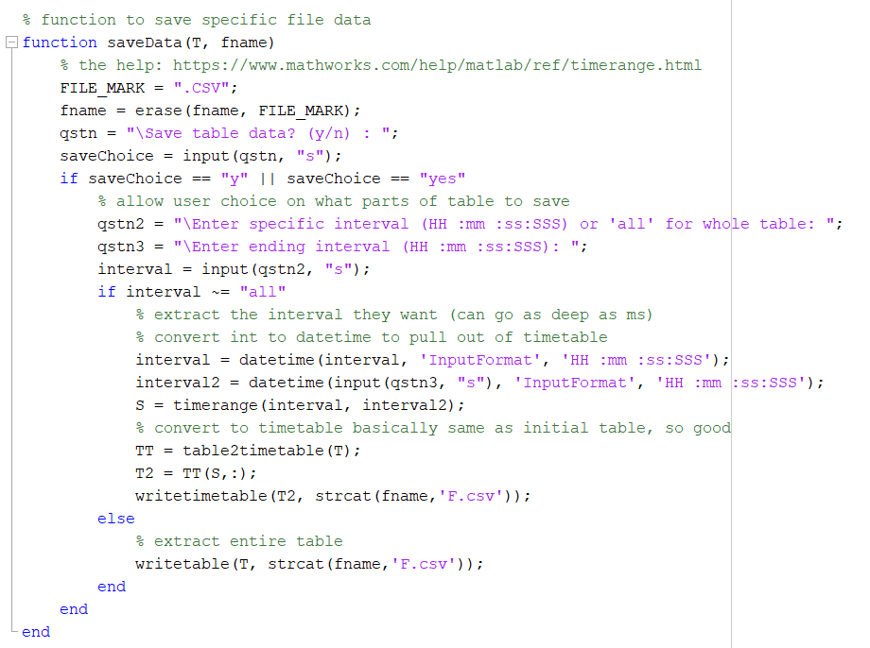
Results: Saving our Data
After processing data, an exportation feature was added to save processed data
New function written to extract processed data as tables in CSV format
Utilizes format → HH:MM:SS:SSS
Fig. 18. Function written to save data for whole table or from user-specified intervals

Slide 16
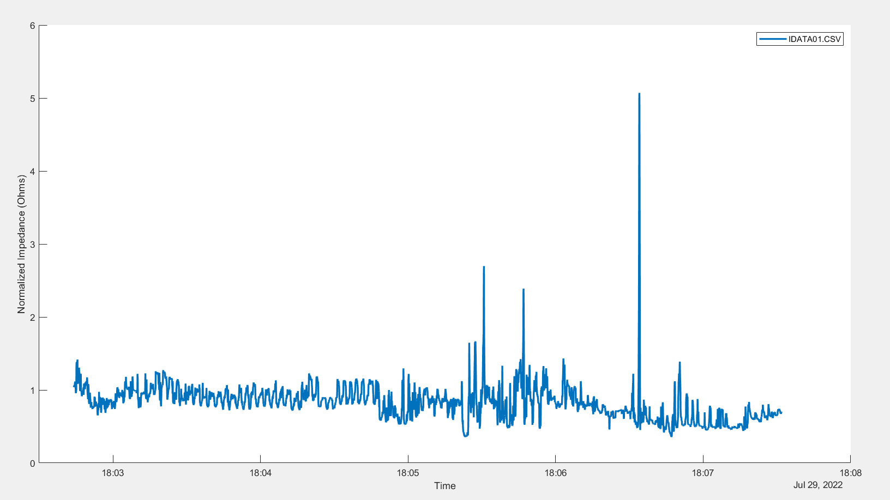
Exporting Data
What if I wanted to save this interval of data?
Fig. 19. Sample datafile plotted with strain

Slide 17
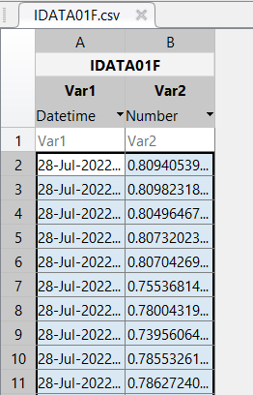
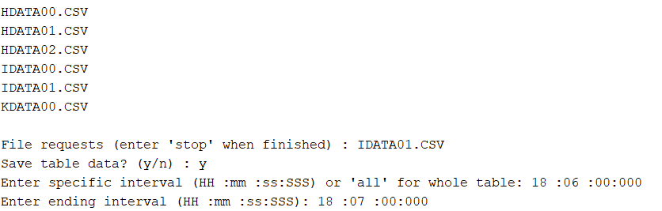

Exporting Data in Portions
Files are locally saved as a table (or portion of table as user-specified)
Fig. 20. User extracting 1 min of data during script operation
Fig. 21. Sample snapshot of 1 min extracted from datafile

Slide 18
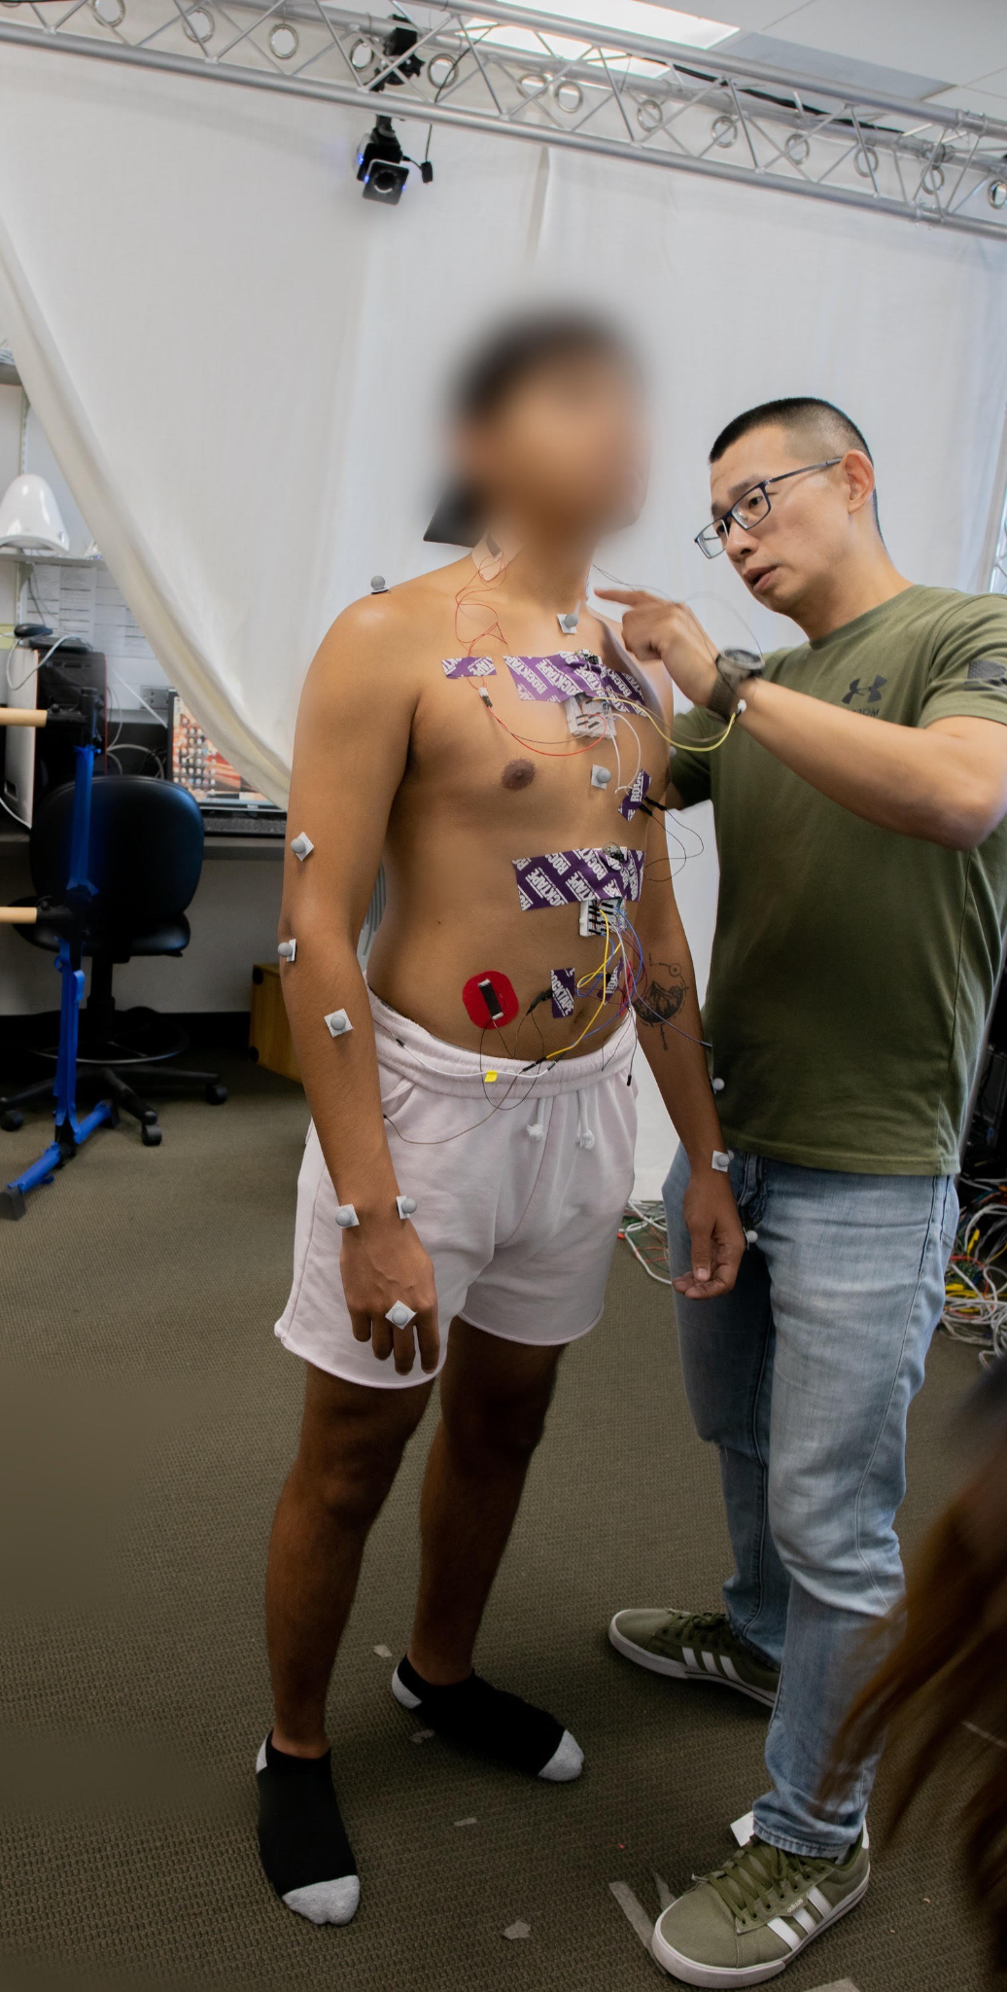
Results Summary
Completed script allows for rapid processing of data following collection
Several plotting schemes available for raw data, impedance, normalized impedance, and FFTs
Data can be exported on command to the millisecond
Script will be deployed for future field tests

Slide 19
Work Cited
Appelle, Aaron, et al. "Wearable Sensor Platform to Monitor Physical Exertion Using Graphene Motion Tape." European Workshop on Structural Health Monitoring. Springer, Cham, 2023.
“Guide to the LaunchPad MSP430FR5994.” Energia.nu, https://energia.nu/pinmaps/msp-exp430fr5994/.
“Wheatstone Bridge Circuit and Theory of Operation.” Basic Electronics Tutorials, 8 Apr. 2021, https://www.electronics-tutorials.ws/blog/wheatstone-bridge.html.

Slide 20
Thank you !

